Slide 1
AdaBoostRegressor Scikit-learn
Hope Learning – Ilango.P 11th August 2025

Slide 2
Overview
AdaBoostRegressor is a meta-estimator that fits a sequence of regressors on modified versions of the data.
It implements the AdaBoost.R2 algorithm and improves performance of weak learners.
Focuses more on difficult cases by adjusting instance weights based on prediction errors.

Slide 3
Constructor Parameters
Function:
AdaBoostRegressor( estimator=None,
n_estimators=50, learning_rate=1.0,
loss='linear’, random_state=None)
Parameter:
- estimator: Base regressor (default: DecisionTreeRegressor(max_depth=3))
- n_estimators: Number of boosting rounds
- learning_rate: Weight applied to each regressor
- loss: Loss function ('linear', 'square', 'exponential')
- random_state: Controls randomness

Slide 4
Attributes
- estimators_: List of fitted sub-estimators
- estimator_weights_: Weights for each estimator
- estimator_errors_: Error of each estimator
- feature_importances_: Feature importance scores
- n_features_in_: Number of features seen during fit
- feature_names_in_: Names of features (if available)

Slide 5
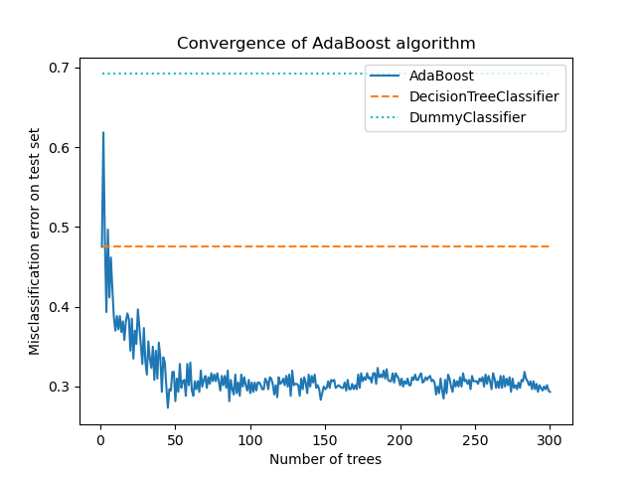

Slide 6
Key Methods
- fit(X, y): Train the model
- predict(X): Predict regression values
- score(X, y): Return R² score
- staged_predict(X): Generator for predictions after each stage
- staged_score(X, y): Generator for scores after each stage

Slide 7
Example Usage
from sklearn.ensemble import AdaBoostRegressor
regressor = AdaBoostRegressor(learning_rate = 0.5, n_estimators = 100)
regressor.fit(X_train,y_train)

Slide 8
AdaBoost Algorithm Diagram
Initialize weights for training data
Train weak learner
Compute error and update weights
Combine weak learners into strong model

Slide 9
Training Process Flowchart
Input Training Data
Initialize Weights
Train Weak Learner
Evaluate Error
Update Weights
Repeat for N Estimators
Final Prediction

